Slide 1

DEEP LEARNING
MODULE # 5 : CONVOLUTIONAL NEURAL NETWORK [CNN]

Slide 2



In This Segment
CNN Architectures
1
Transfer Learning
2
Further Reading
3

Slide 3
LeNet 5
Every convolutional layer includes three parts: convolution, pooling, and nonlinear activation functions.
Using convolution to extract spatial features.
Conv filters were 5x5, applied at stride 1.
Subsampling average pooling layer. Subsampling (Pooling) layers were 2x2 applied at stride 2.
tanh activation function.
Using MLP as the last classifier.
Architecture is [CONV-POOL-CONV-POOL-FC-FC]
Sparse connection between layers to reduce the complexity of computation.

Slide 4
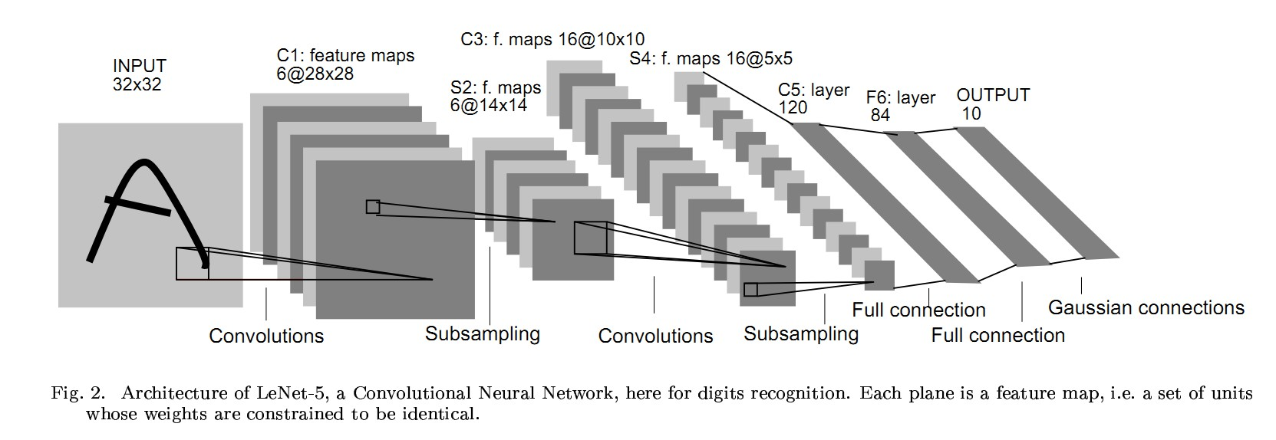
LeNet-5

Slide 5
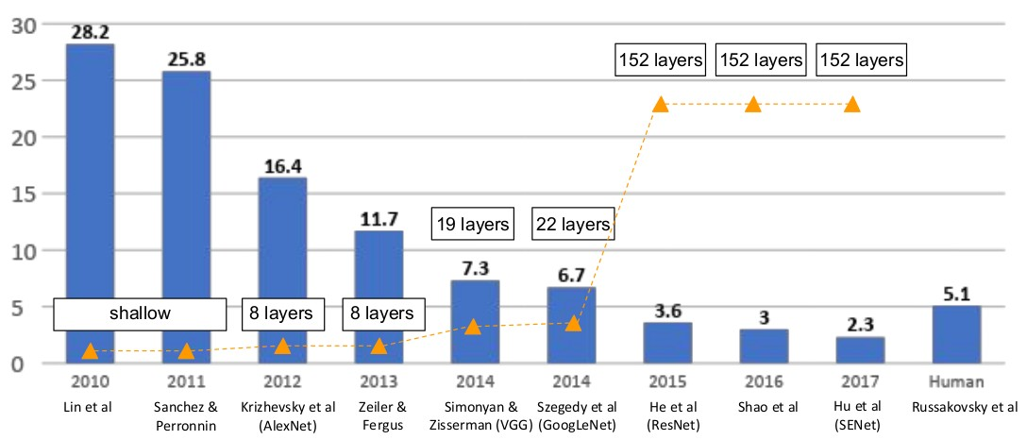
ImageNet Large Scale Visual Recognition
Fei-Fei Li, Jiajun Wu, Ruohan Gao

Slide 6
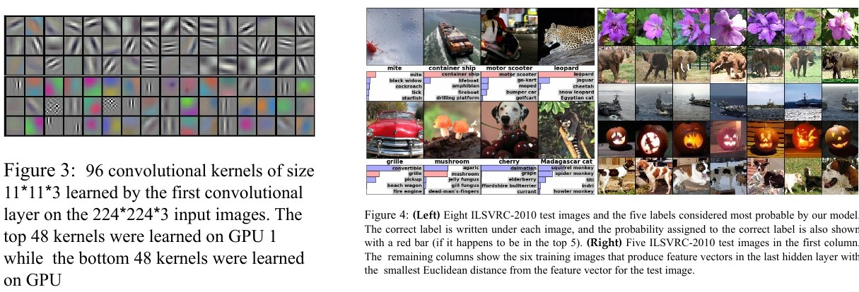
ImageNet Data

Slide 7
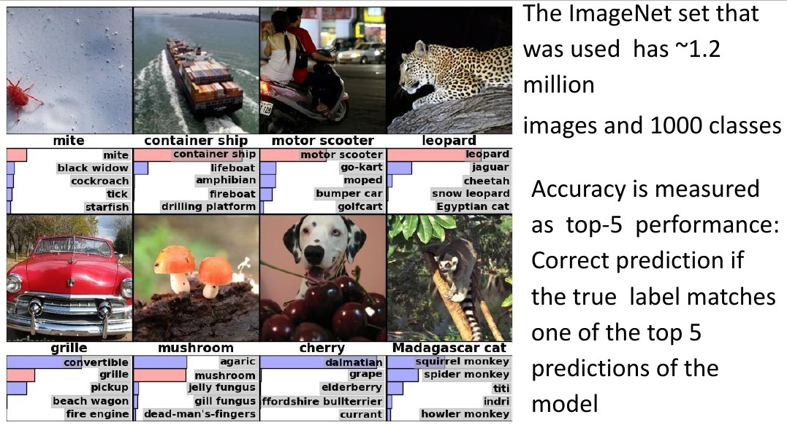
ImageNet Data

Slide 8
AlexNet
AlexNet competed in the ImageNet Large Scale Visual Recognition Challenge on September 30, 2012.[3] The network achieved a top-5 error of 15.3%, more than 10.8 percentage points lower than that of the runner up.
Details/Retrospectives:
first use of ReLU
used Local Response Normalisation (LRN) layers (not common anymore)
Approx. 60 million parameters are learned.
heavy data augmentation
dropout 0.5
batch size 128
SGD Momentum 0.9
Learning rate 1e − 2, reduced by 10 manually when val accuracy plateaus
L2 weight decay 5e − 4
7 CNN ensemble: 18.2%− > 15.4%
Fei-Fei Li, Jiajun Wu, Ruohan Gao

Slide 9
AlexNet Architecture
227x227x3 INPUT
55x55x96 CONV1 : 96 11x11 filters at stride 4, pad 0 27x27x96
MAX POOL1 : 3x3 filters at stride 2 27x27x96
NORM1 : Normalization layer 27x27x256
CONV2 : 256 5x5 filters at stride 1, pad 2 13x13x256
MAX POOL2 : 3x3 filters at stride 2 13x13x256
NORM2 : Normalization layer 13x13x384
CONV3 : 384 3x3 filters at stride 1, pad 1 13x13x384
CONV4 : 384 3x3 filters at stride 1, pad 1 13x13x256
CONV5 : 256 3x3 filters at stride 1, pad 1 6x6x256
MAX POOL3 : 3x3 filters at stride 2
4096 FC6 : 4096 neurons
4096 FC7 : 4096 neurons
1000 FC8 : 1000 neurons (class scores)

Slide 10
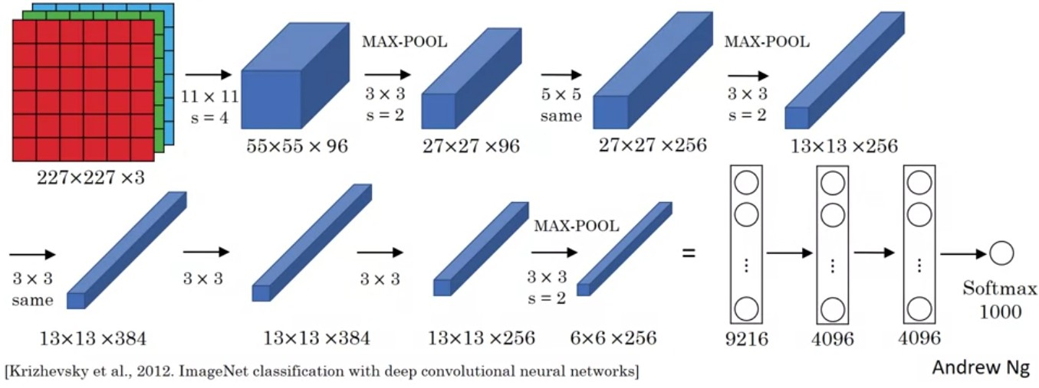
AlexNet

Slide 11
VGG 16
VGG stands for Visual Geometry Group with 16 Layers
Plug and play in Caffe
Deeper the better
Details
ILSVRC’14 2nd in classification, 1st in localization
Similar training procedure as Krizhevsky 2012
Approx. 138 million parameters are learned.
No Local Response Normalisation (LRN)
Use VGG16 or VGG19 (VGG19 only slightly better, more memory)
Use ensembles for best results
All convolutions with a 3 × 3 kernel
All max-pooling layers with a 2 × 2 kernel
FC7 features generalize well to other tasks
Fei-Fei Li, Jiajun Wu, Ruohan Gao

Slide 12
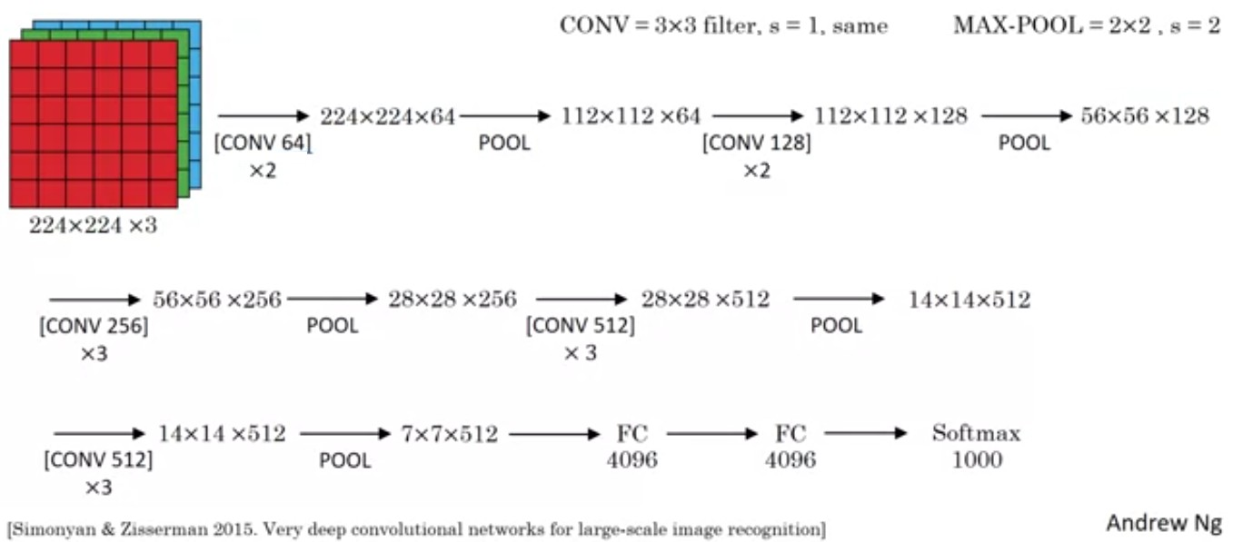
VGG 16

Slide 13
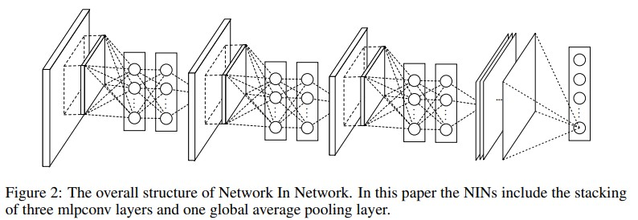
Network in Network
A convolution kernel can be thought of as a generalized linear model (GLM).
Using a sophisticated non-linear function approximator like MLP, enhance the abstraction ability of the local model.
Replace GLM by micro network.
Replace the MLP micro structure via convolutions.
Replace fully connected layers in the last layers by global average pooling.

Slide 14
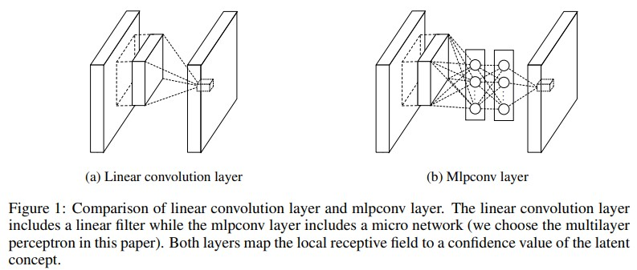
Network in Network
Using micro-networks allow to extract more sophisticated features and may need fewer extractors and can avoid learning too simple or redundant features.

Slide 15
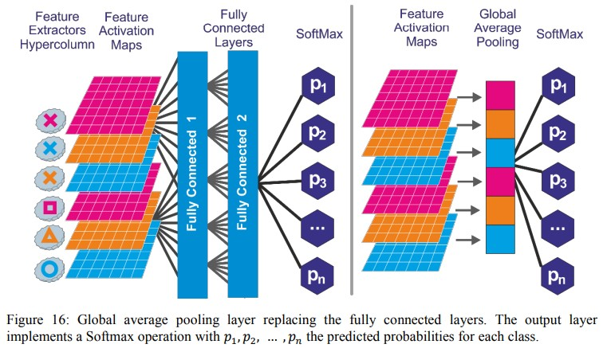
Network in Network
Fully connected layers have a lot of learnable parameters and may cause overfiting. Replace FC by global average pooling for better generalization.
Figure Source: Singh, Anshuman Vikram. ”Content-based image retrieval using deep learning.” (2015)

Slide 16
GoogLeNet / Inception Net
ILSVRC’14 classification winner (6.7% top 5 error) 22 layers with weights
Only 5 million parameters (12x less than AlexNet and 27x less than VGG-16)
Inception Module - convolutional “blocks” – efficient
Design a good local network topology (network within a network) and then stack these modules on top of each other.
Linear layers at the end
Max pooling in between, multiple Conv layers between pooling
Great ideas for data augmentation
Deeper networks, with computational efficiency
No FC layers.
After the last convolutional layer, a global average pooling layer is used that spatially averages across each feature map, before final FC layer.

Slide 17
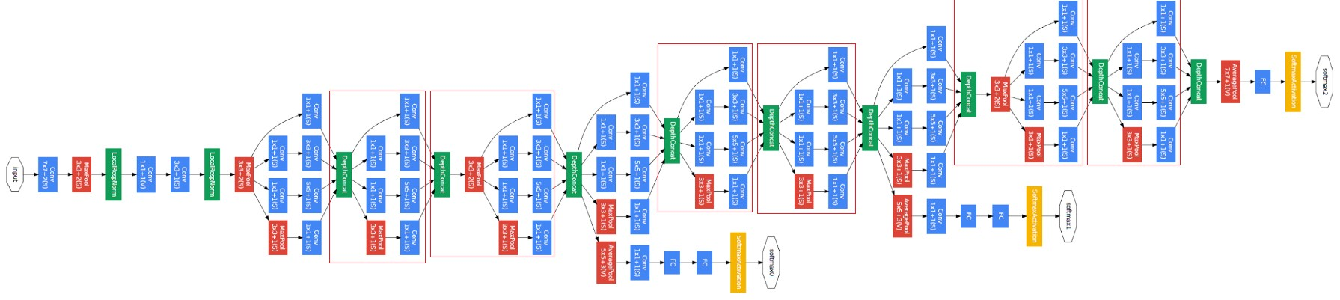
Inception Net

Slide 18
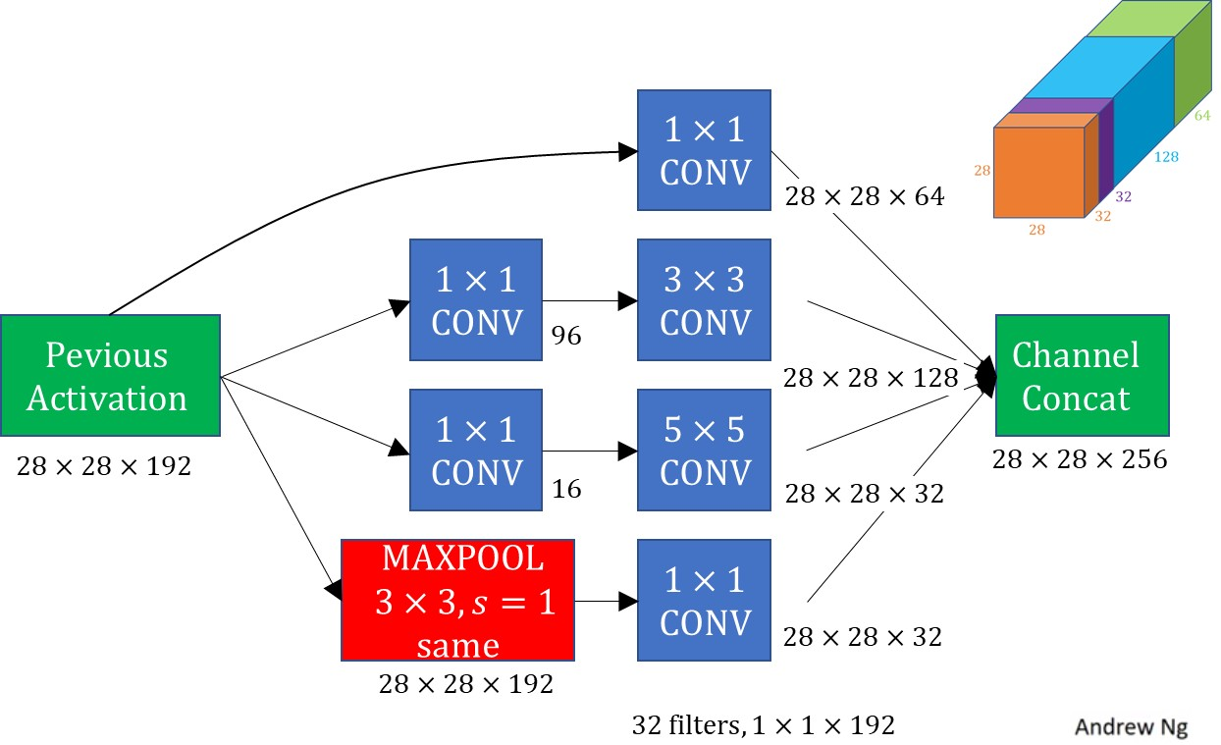
Inception Net Module

Slide 19
Inception Net Module
Apply parallel filter operations on the input from previous layer.
Multiple receptive field sizes for convolution (1x1, 3x3, 5x5) and Pooling operation (3x3).
Concatenate all filter outputs together channel-wise.
Very expensive compute
1x1 convolutions to reduce feature channel size.
Assume an input of WxHx64.
Each filter has size 1x1x64, and performs a 64-dimensional dot product.
Preserves spatial dimensions, reduces depth.
Projects depth to lower dimension (combination of feature maps).

Slide 20
Residual Net (ResNet)
Very deep networks using residual connections
152-layer model for ImageNet
ILSVRC’15 classification winner (3.57% top 5 error)
Swept all classification and detection competitions in ILSVRC’15 and COCO’15.
Add residual connections between convolution blocks
Easy gradient flow for deep models
Enable very deep models (from 20 layers to 150 and even 1000 layers!)
No linear layers except classifier.
Solve the problems of vanishing gradients using Residual connections.

Slide 21
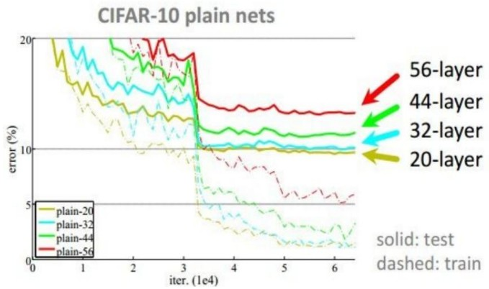
ResNet Block
What happens when we continue stacking deeper layers on a convolutional neural network?
The deeper model performs worse, but it’s not caused by overfitting.

Slide 22
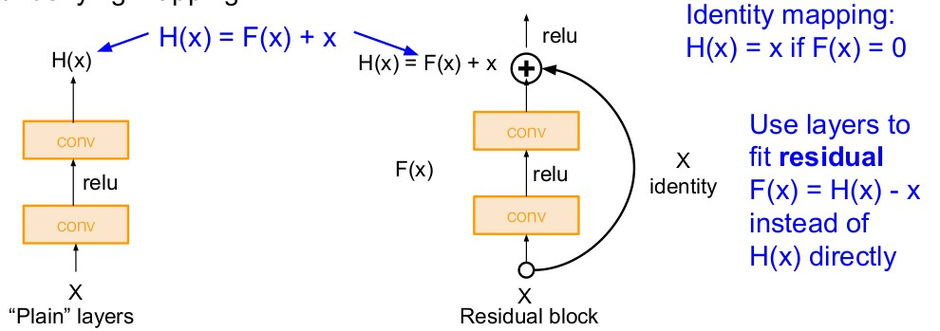
ResNet Block
Solution: Use network layers to fit a residual mapping instead of directly trying to fit a desired underlying mapping.
Fei-Fei Li, Jiajun Wu, Ruohan Gao

Slide 23
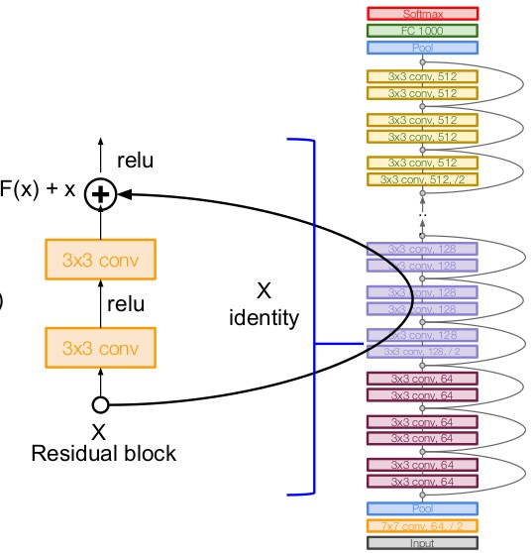
ResNet
Fei-Fei Li, Jiajun Wu, Ruohan Gao

Slide 24
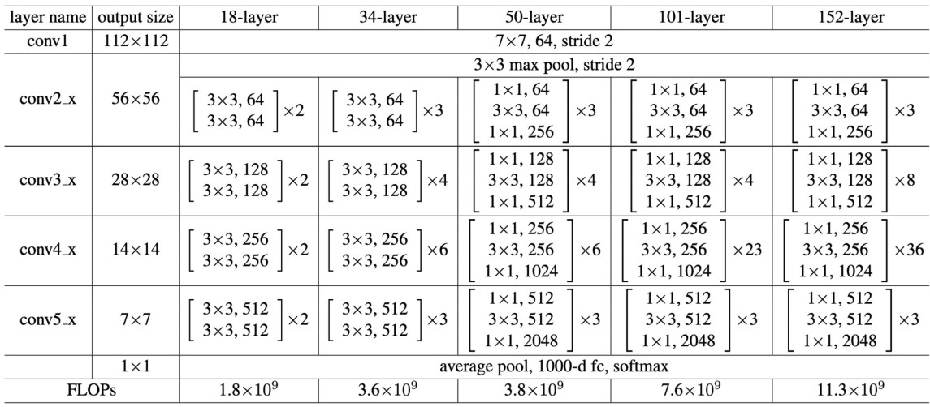
ResNet Modules

Slide 25
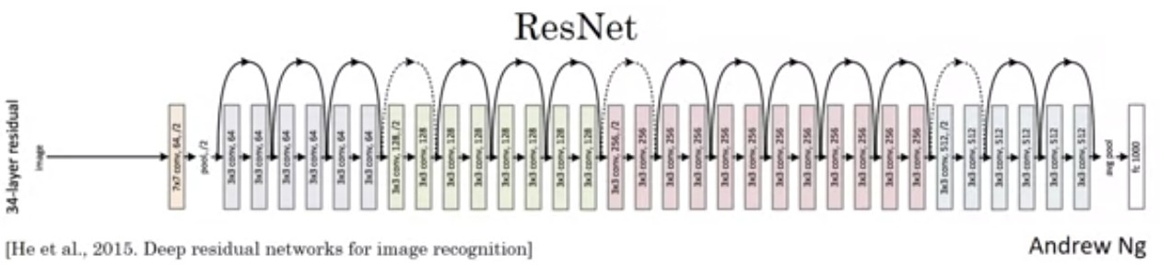
ResNet

Slide 26
ResNet architecture
Stack residual blocks
Every residual block has two 3x3 conv layers
Periodically, double # of filters and downsample spatially using stride 2. Reduce the activation volume by half.
Additional conv layer at the beginning (stem).
No FC layers at the end (only FC 1000 to output classes)
Total depths of 18, 34, 50, 101, or 152 layers for ImageNet.
Training ResNet in practice:
Batch Normalization after every CONV layer
Xavier initialization from He et al.
SGD + Momentum (0.9)
Learning rate: 0.1, divided by 10 when validation error plateaus
Mini-batch size 256
Weight decay of 1e-5
No dropout used

Slide 27
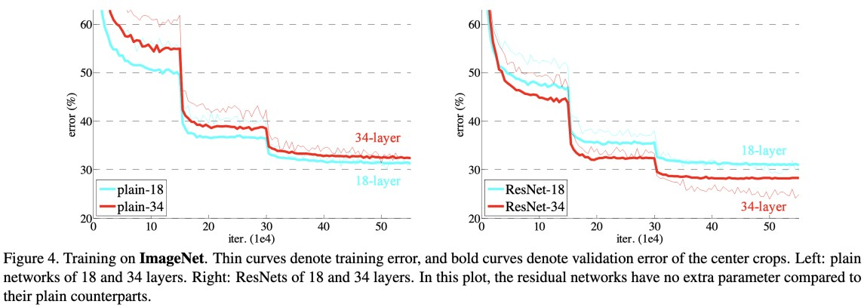
Efficacy of ResNet
https://arxiv.org/abs/1512.03385

Slide 28
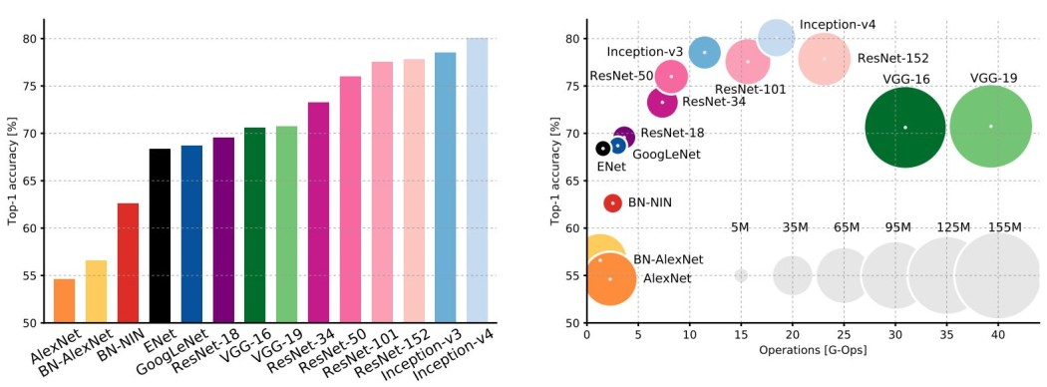
Comparing complexity

Slide 29
Comparing complexity
Inception-v4: Resnet + Inception – more accuracy VGG: most parameters, most operations GoogLeNet: most efficient
AlexNet: Smaller compute, still memory heavy, lower accuracy ResNet: Moderate efficiency depending on model, highest accuracy

Slide 30
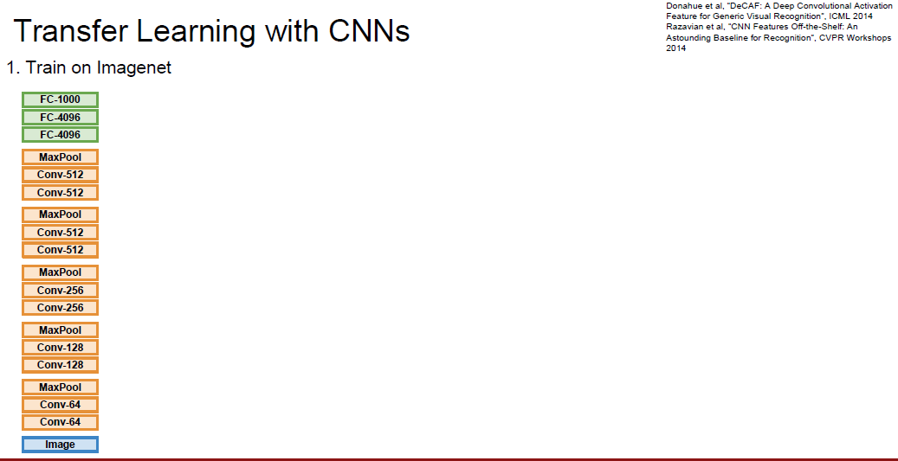
Transfer Learning
Fei-Fei Li & Justin Johnson & Serena Yeung

Slide 31
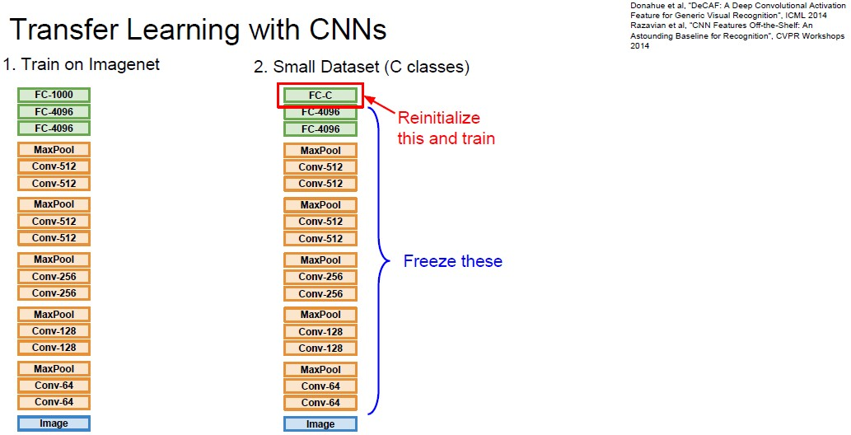
Transfer Learning
Fei-Fei Li & Justin Johnson & Serena Yeung

Slide 32
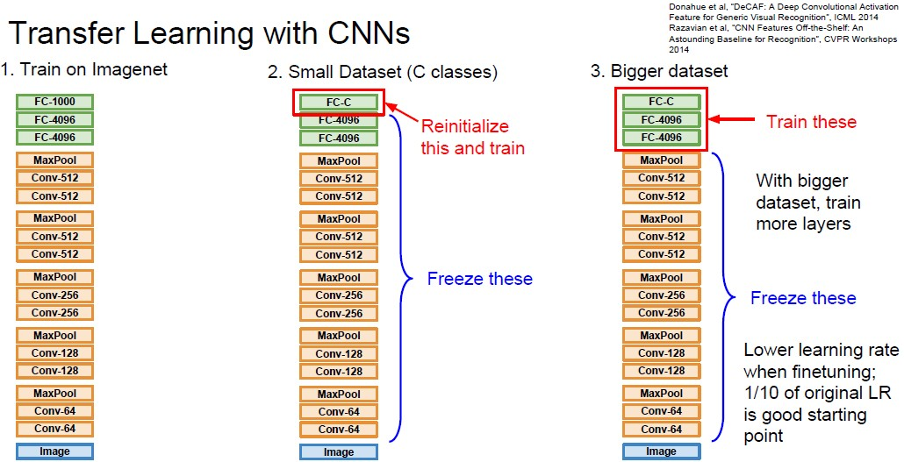
Transfer Learning
Fei-Fei Li & Justin Johnson & Serena Yeung

Slide 33
Transfer Learning for Image Data
Use a deep learning model that is pre-trained on large dataset like ImageNet or MS Coco.
Oxford VGG Model
Google Inception
Model Microsoft
ResNet Model

Slide 34
Transfer Learning for Text Data
Embedding is the mapping of words to a high-dimensional continuous vector space where different words with similar meanings have similar vector representations.
Google’s word2vec Model
Stanford’s GloVe Model
FastText
Gensim

Slide 35
Transfer Learning - when to use?
You need a lot of a data if you want to train/use CNNs / RNNs.
Task A and Task B have the same type of input. Eg: Input is images for both tasks.
We have lot of data for training Task A and relatively low data for training in Task B.
Low level features obtained from Task A could be more helpful for learning Task B.

Slide 36
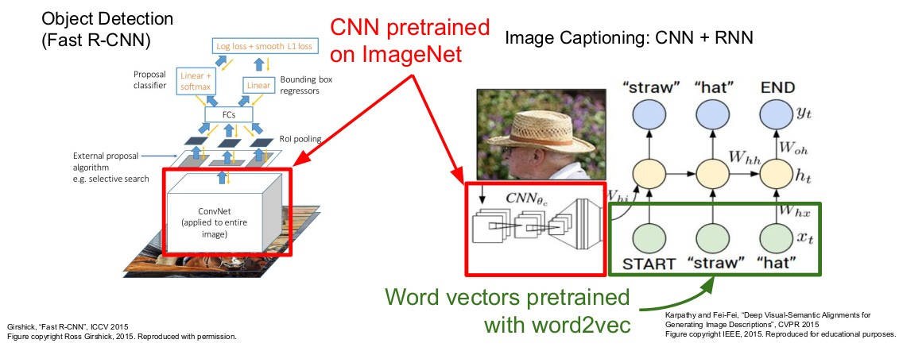
Transfer Learning Example
Fei-Fei Li, Jiajun Wu, Ruohan Gao

Slide 37


In This Segment
CNN Architectures
1
Transfer Learning
2
Further Reading
3

Slide 38
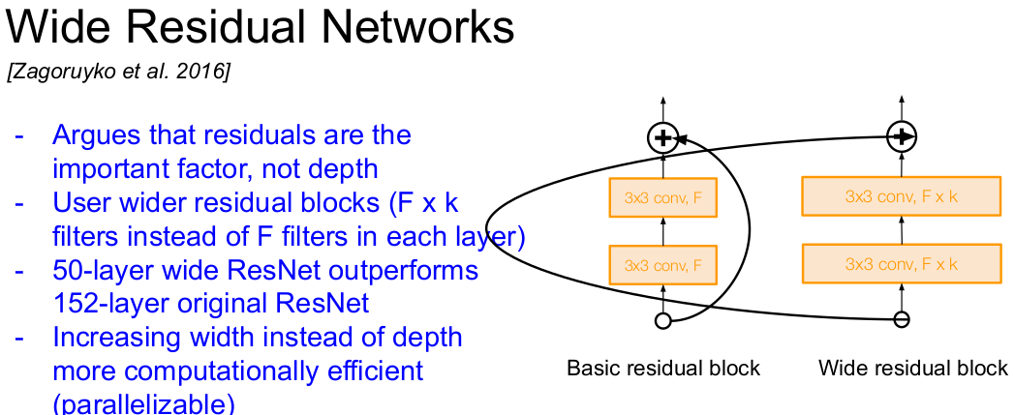
Fei-Fei Li, Jiajun Wu, Ruohan Gao

Slide 39
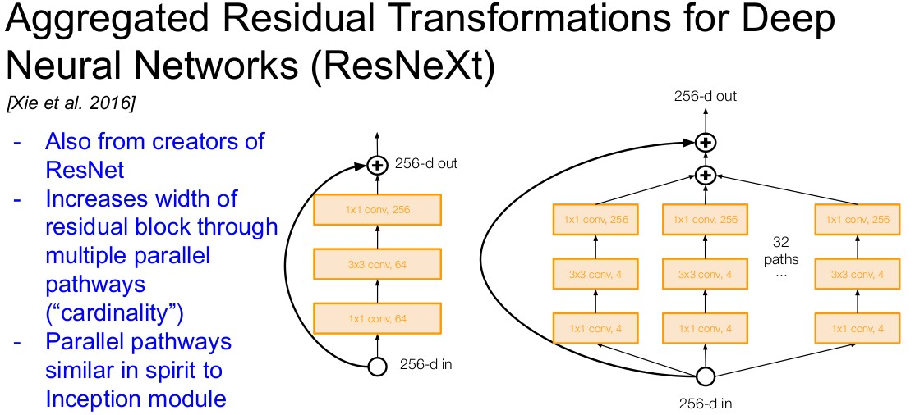
Fei-Fei Li, Jiajun Wu, Ruohan Gao

Slide 40
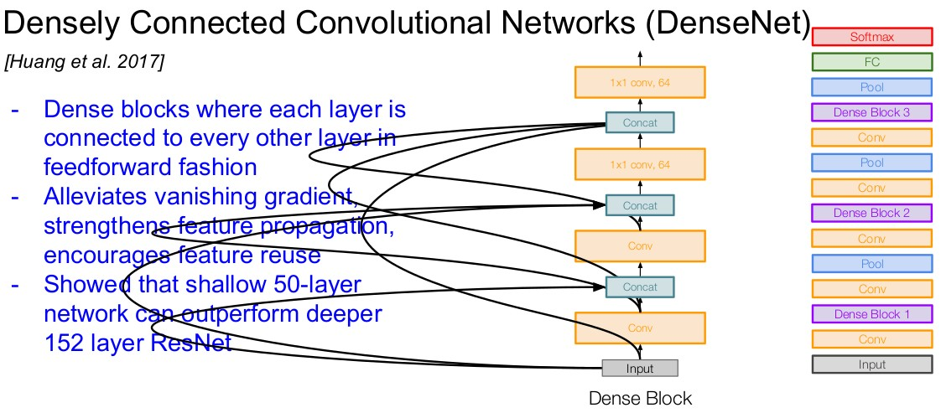
Fei-Fei Li, Jiajun Wu, Ruohan Gao

Slide 41
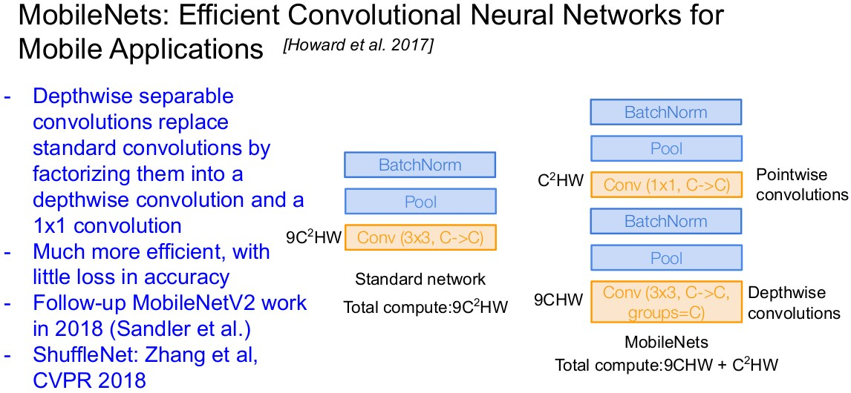
Fei-Fei Li, Jiajun Wu, Ruohan Gao

Slide 42
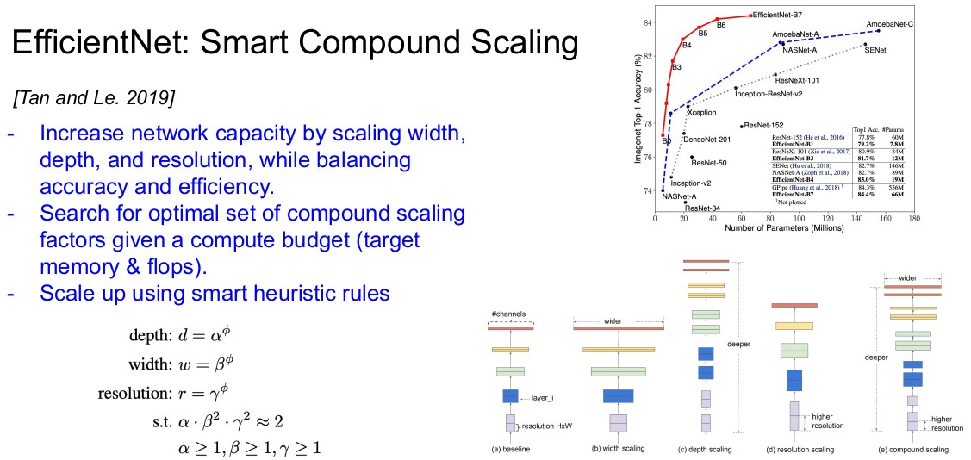
Fei-Fei Li, Jiajun Wu, Ruohan Gao

Slide 43
References
Refer Chapter 8 of Dive into Deep Learning book.
LeNet5 : Yann Lecun and Leon Bottou and Yoshua Bengio and Patrick Haffner, Gradient-based learning applied to document recognition, IEEE-1998
AlexNet : Imagenet classification with deep convolutional neural networks, Krizhevsky, Alex and Sutskever, Ilya and Hinton, Geoffrey E, In: Advances in neural information processing systems, NIPS 2012
VGG16 : Simonyan, Karen, and Andrew Zisserman. ”Very deep convolutional networks for large-scale image recognition.”
Inception v1 : Going deeper with convolutions, Szegedy, Christian et.al CVPR 2015
ResNet : Deep residual learning for image recognition, He et.al CVPR-2016

Slide 44


